Slide 1



Socket.IO and
Testing Node
Dynamic Client-Server using Socket.IO
Testing Node Applications

Slide 2


Objectives
Develop proper understanding of Web Socket Mechanism
Include Socket.IO in your Application
Develop a chat application which includes different features

Slide 3

Objectives
Broadcast the message via Chat Application
Develop proper understanding of Testing Mechanism
Classify Different types of Automated testing

Slide 4

Objectives
Performance Native testing and debugging
Gain knowledge on Mocha and Chai
Perform Testing using Mocha and Chai

Slide 5

Socket.IO

Slide 6

Web Socket
Half Duplex communication setup- HTTP protocol is not suitable for a chat application.
This drawback is overcome by a web-socket protocol that permits Full-duplex communications.
Web socket sets a persistent connection between the client and the server.
Full-duplex communication means both client and server can communicate and exchange data at the same time.

Slide 7
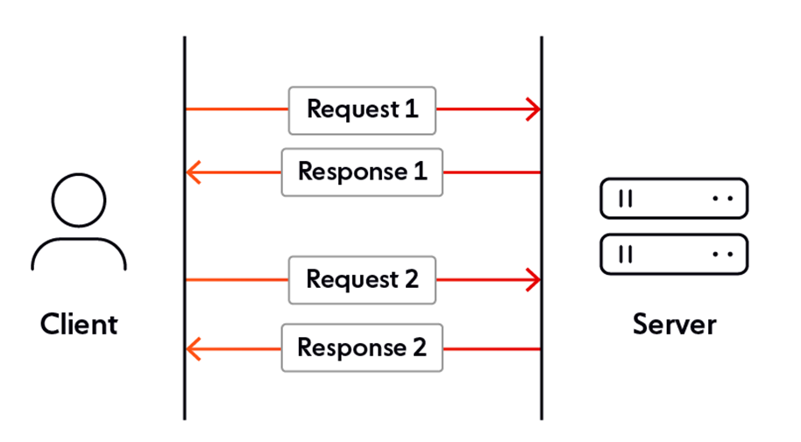
How does Web Socket works?

Slide 8
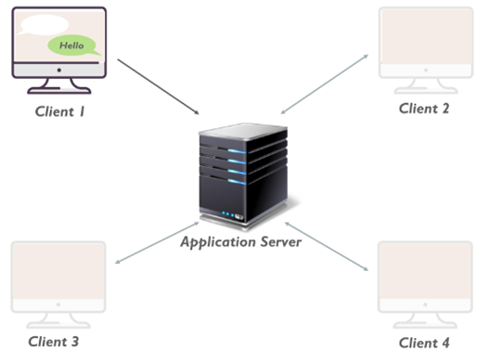
Working of Web-Socket
Every client has a persistent connection with the server, so server delivers the message to the rest clients without receiving the request. Clients send the message to the server.

Slide 9

Socket.io
Socket.io is a library that enables real-time, bidirectional and event-based communication.
Socket.IO works between the browser/client and the server.
Its support a wide range of web browsers including the old crufty browsers.
It consists of Node.js server and a JavaScript client for browser.
You can install it using: npm install socket.io

Slide 10
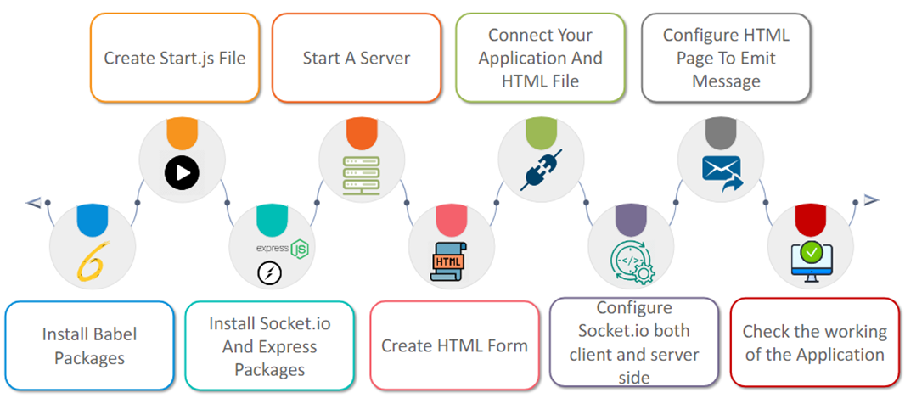
MAJOR SECTIONS OF CHAT APPLICATION

Slide 11
NodeJS Testing

Slide 12
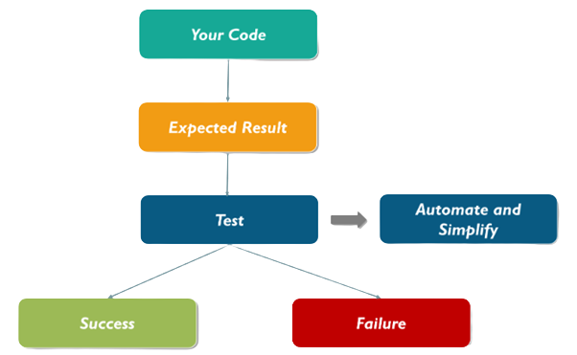
Automated Testing
Steps involved while testing:
Automated Testing is the technique used to test and compare the actual outcome with the expected outcome, where new information is continuously fed back into the process.

Slide 13




Benefits of Automated Testing
1
Reduces Maintenance Cost
2
Improves accuracy
3
Increase speed of test execution
4
Saves time and money
5
Minimise the human interacting with testing
Write the test case once and run as many time you want
6

Slide 14
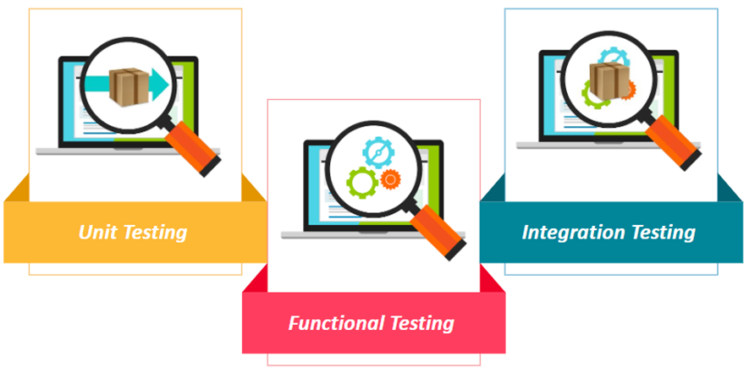
Types of Automated Testing

Slide 15
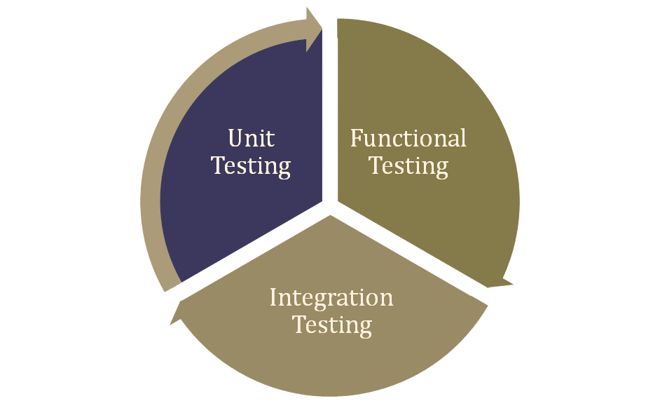

Slide 16

UNIT TESTING
Unit test is used to test small pieces of independent code.
Your code cannot contain external resources like network or database.
Used to prevent regressions(Bugs that occur repeatedly).
Easy to pinpoint and then fix the problem.
Popular tool for unit testing include Mocha.

Slide 17
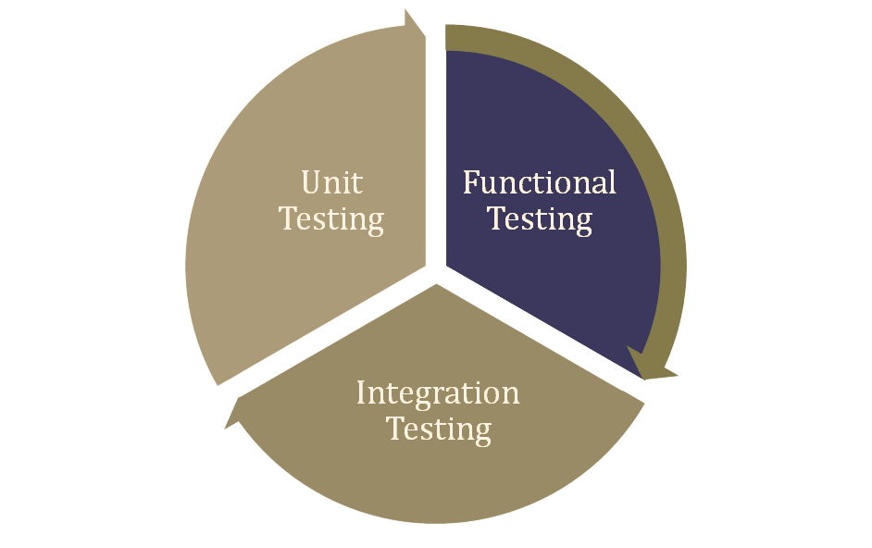

Slide 18

Function Testing
Functional test are made against combinations of many units.
You can use any number of external objects or systems like databases, UI, etc.
Takes a longer time to execute than unit test.
Unit test represents only minor changes expected to change less often than a unit test.
We can easily see that this functional group will comprise many unit tests.

Slide 19
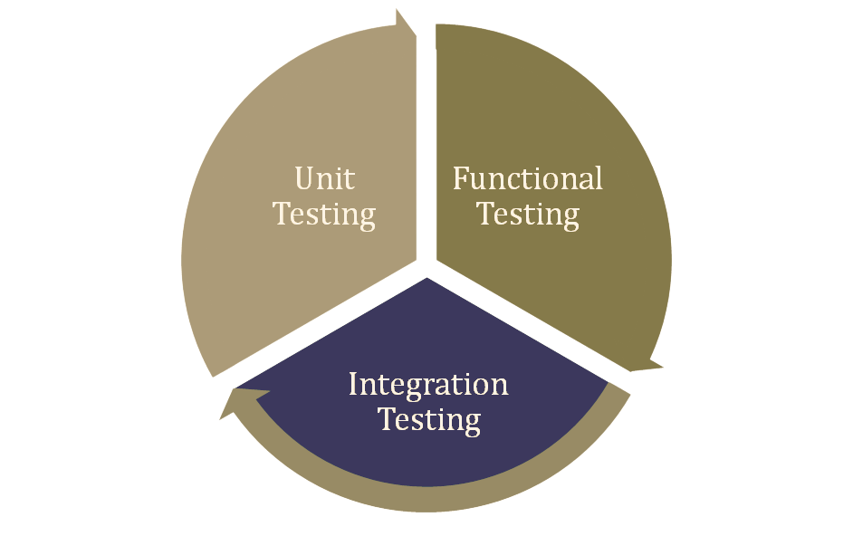

Slide 20



Integration Test
Integration testing ensure that the entire system application is working correctly
It can be executed only within a realistic environment like a real database or serve
It is used in case you need to test separate systems like database and application
It is slower than other tests as it complex to write

Slide 21
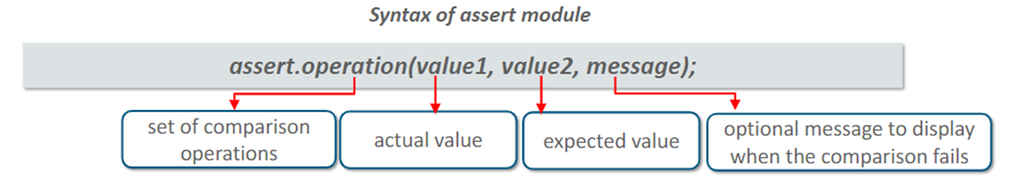
Assert Module
This Module was internally built in Node.js to test whether we get the desired output or not.
It only returns a value when the assertion fails.

Slide 22
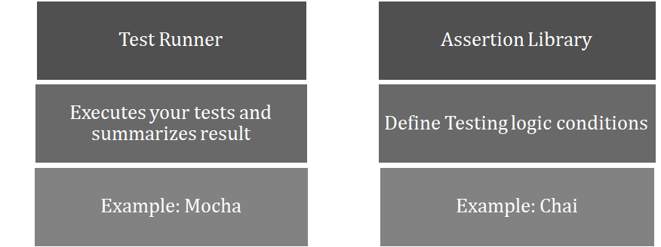
Advance Testing Setup

Slide 23



What is Mocha?
Mocha is a JavaScript framework test runs on Node.js as well as browser.
It does not concern itself whit the test assertions themselves.
How to Install Mocha Globally?
Mocha uses ‘describe’ and ‘it’ operates to organise and run your tests:

Slide 24
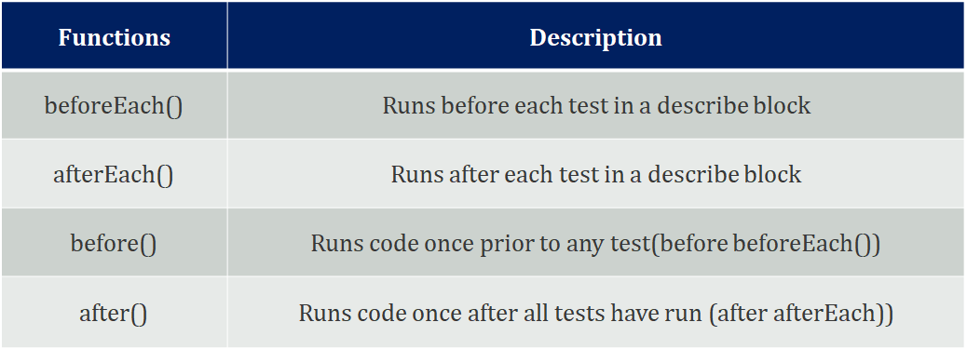
Hooks In Mocha

Slide 25
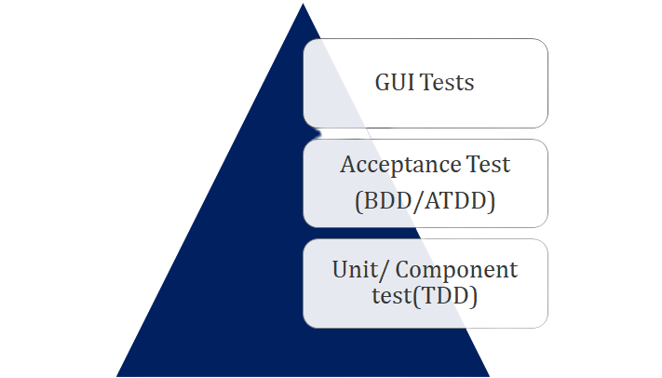
Chai
Chai is a BDD(Behaviour Driven Development)/TDD(Test Driven Development) assertion library for node and the browser, offering assertion styles: expect, should, and assert.

Slide 26
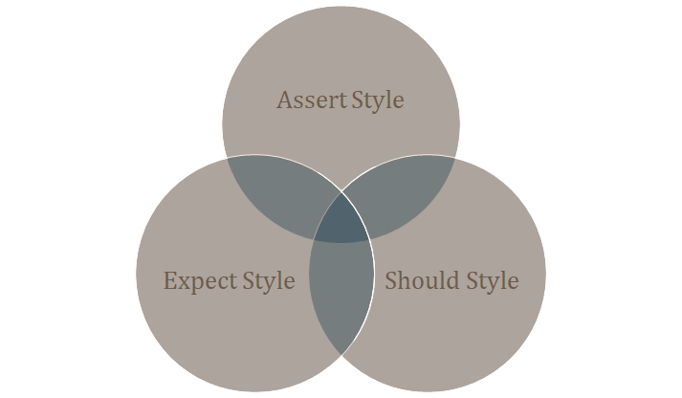
Assertion Styles
Chai offers mainly three assertion styles:

Slide 27
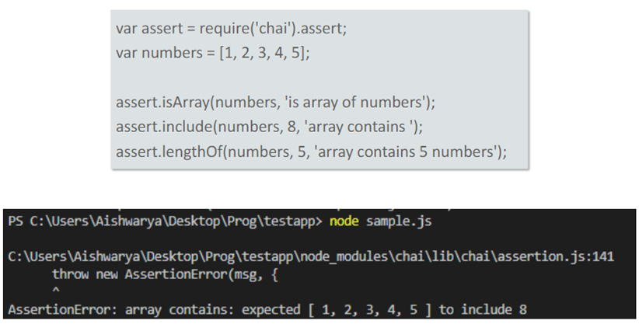
Assertion Style: Assert Style
Assert Style is exposed through assert interface, it is like the in-built assert module in Node.js with additional tests.

Slide 28

Thank you!

